Slide 1

RipeVision.AI
Development of Tomato Maturity Level
Prediction Software Using Advanced Artificial Intelligence
Techniques
Sumedha Koranga : 54798
Under the Supervision of
Dr. N. C. Shahi

Slide 2
Contents
Introduction
Review of Literature
Dataset
Transfer Learning using MobileNet
Data Augmentation
Models
Android Application Interface
Android Application Results
Conclusion
Sumedha Koranga (54798)

Slide 3
Introduction
01
Importance of Maturity Level Detection
04
Existing Methods
Image Processing and specialized hardware
Indicators of Maturity Level
Problems
02
05
Size and Color
Expensive and inaccessible
03
Human Inspection
06
Suggested Solution
Error-prone and time-consuming
Easy-to-use Android Application
Sumedha Koranga (54798)

Slide 4
Review of Literature
Specialized Hardware
Odor Sensors
Some existing approaches
Image Processing
Distance between stem root and tomato height
Classical ML
Logistic Regression and Support Vector Machine
Artificial Neural Networks
Multi-layer perceptron
Sumedha Koranga (54798)

Slide 5
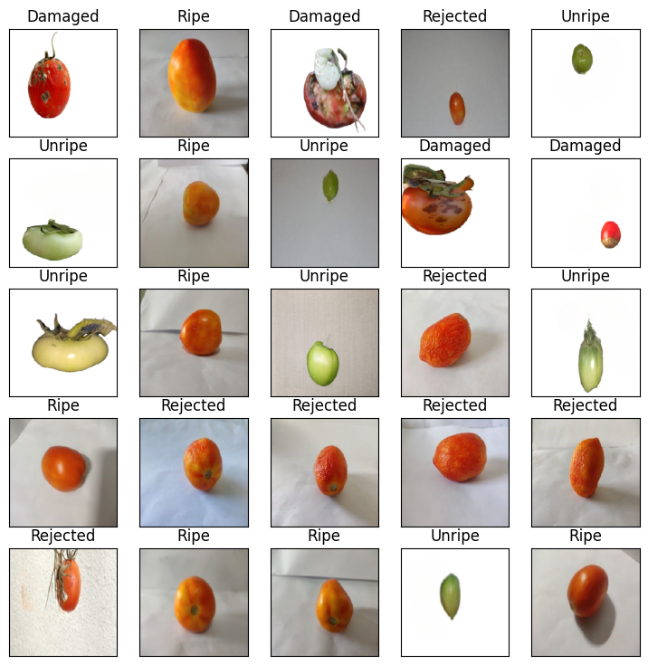
Dataset
01
2,036 images
02
Four Classes: Unripe, Ripe, Rejected and Damaged
03
RGB Color Space
Sumedha Koranga (54798)

Slide 6
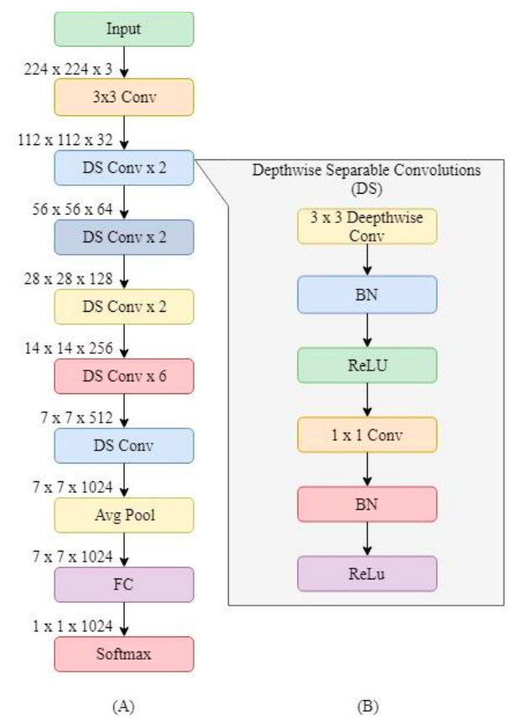
Transfer Learning using MobileNet
Sumedha Koranga (54798)

Slide 7
Data Augmentation
01 | Horizontal and vertical shift augmentation
02 | Horizontal and vertical flip augmentation
03 | Random rotation augmentation
04 | Random brightness augmentation
05 | Random zoom augmentation
Sumedha Koranga (54798)

Slide 8
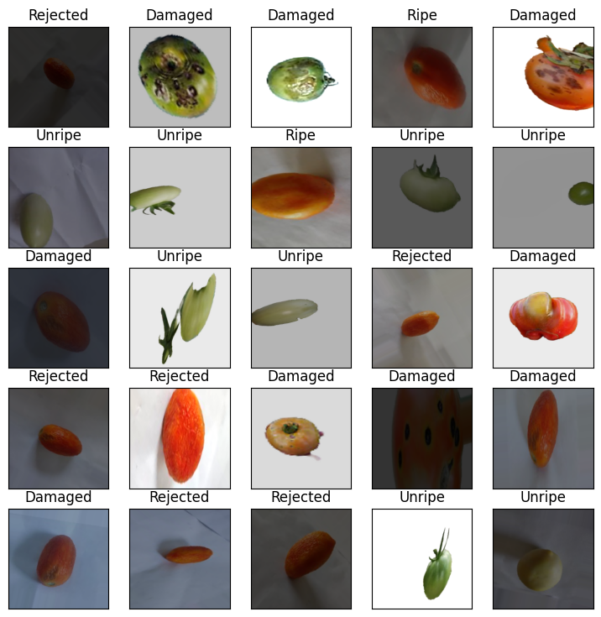
Data Augmentation - Light
01
Rotation
02
Brightness
03
Zoom
04
Flip
Sumedha Koranga (54798)

Slide 9
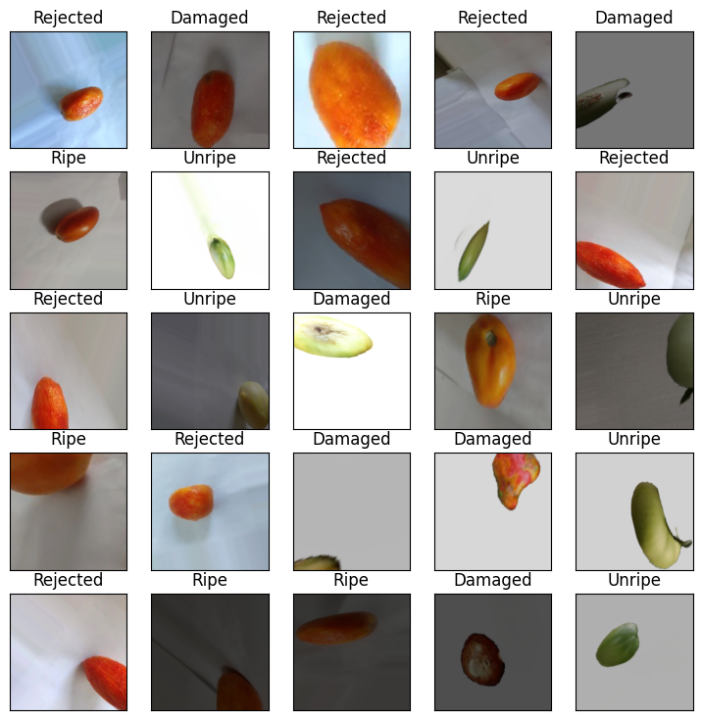
Data Augmentation - Heavy
01
Rotation
02
Brightness
03
Zoom
04
Flip
05
Shift
06
Shear
Sumedha Koranga (54798)

Slide 10
Models
02
01
Tomato Classifer Pro
Deep Learning CNN trained on Light Data Augmentation dataset
03
Tomato Classifer
Deep Learning CNN model trained on original dataset
Tomato Classifer Pro 2
Deep Learning CNN trained on Heavy Data Augmentation dataset
Sumedha Koranga (54798)

Slide 11
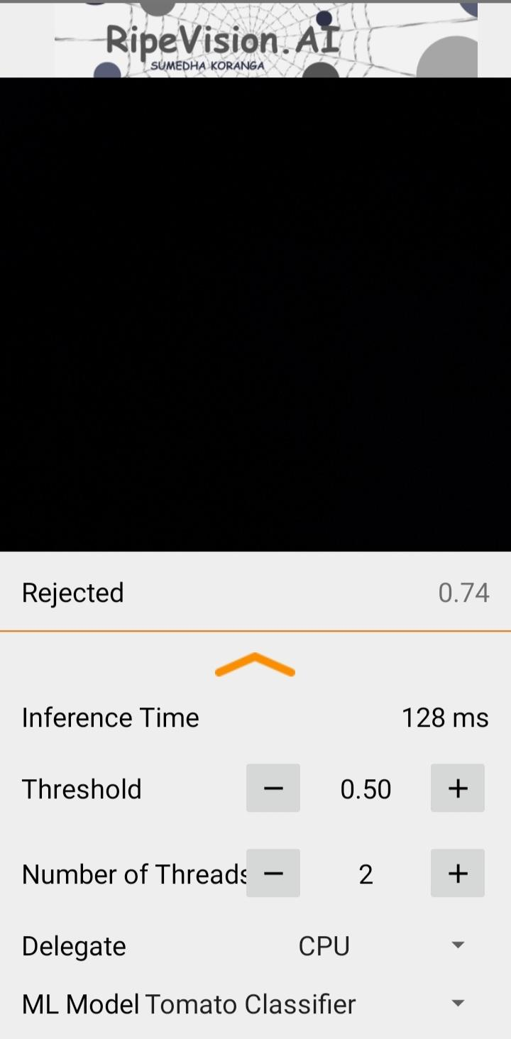
Android Application Interface
Sumedha Koranga (54798)

Slide 12
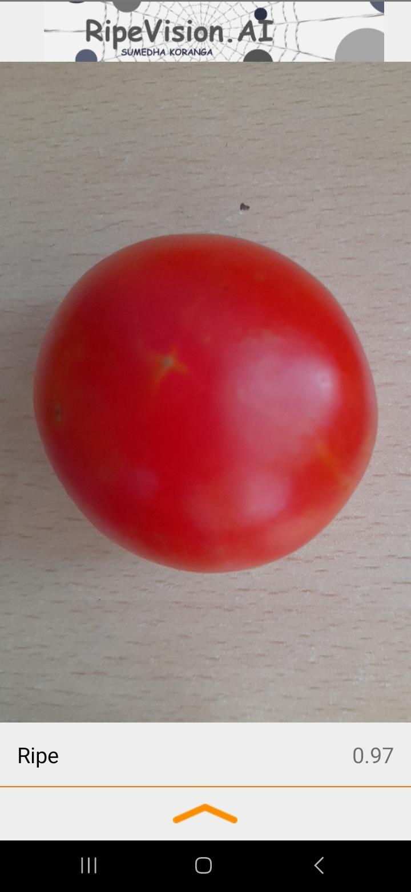
Android Application Performance
Sumedha Koranga (54798)

Slide 13
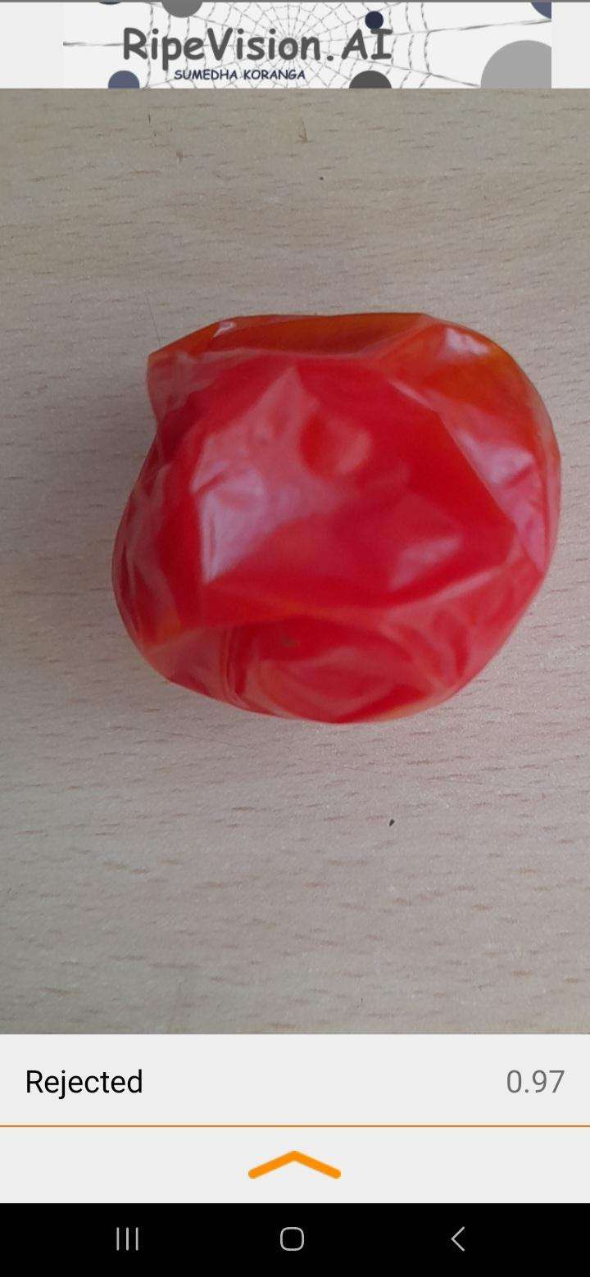
Android Application Performance
Sumedha Koranga (54798)

Slide 14
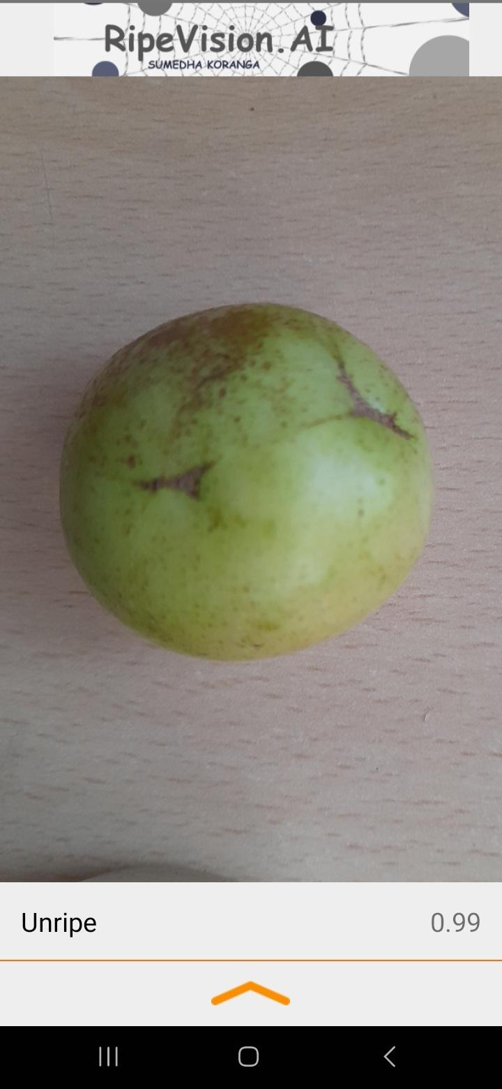
Android Application Performance
Sumedha Koranga (54798)

Slide 15
Conclusion
Prediction Quality
01
02
Innovation
The prediction are highly accurate
Light-weight model which can be run in any standard device
Trustworthy
03
Cost reduction
04
Application indicate the model confidence level
Application can be installed in any Android device
Sumedha Koranga (54798)

Slide 16
Thank You!!!
Please ask any questions
Sumedha Koranga (54798)

